Slide 1
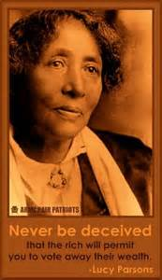

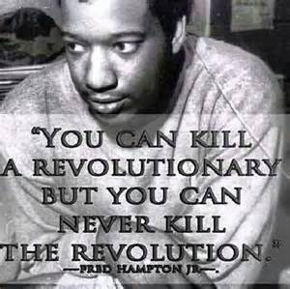
Joko Teach-In:Modern revolutions and the African-Our Agency, Our Centrality, Our Outcomes
A Survey of Modern Revolutions and Reform

Slide 2
Definitions from Merriam Webster’s Collegiate Dictionary, Tenth Edition
Revolution: “b : a fundamental change in political organization, esp. : the overthrow or renunciation of one government or ruler and the substitution of another by the governed c : activity or movement designed to effect fundamental change in the socioeconomic situation d : a fundamental change in the way of thinking about or visualizing something : a change in paradigm < the Copernican Revolution > e : a changeover in use or preference esp. in technology”

Slide 3
Definitions from Merriam Webster’s Collegiate Dictionary, Tenth Edition
Reform(1): “ 1 a : to put or change into an improved form or condition b : to amend or improve by change of form or removal of faults or abuses 2 : to put an end to (an evil) by enforcing or introducing a better method or course of action 3 : to induce or cause to abandon evil ways < reform a drunkard > … ~ vi : to become changed for the better…”
Reform(2) n (1663) 1 : amendment of what is defective, vicious, corrupt, or depraved 2 : a removal or correction of an abuse, a wrong, or errors…”

Slide 4
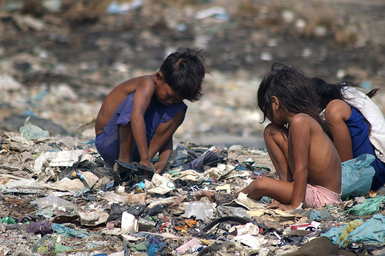
Property Relations and Social Relations
c : activity or movement designed to effect fundamental change in the socioeconomic situation

Slide 5
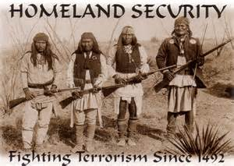
New Property Relations since 1492

Slide 6
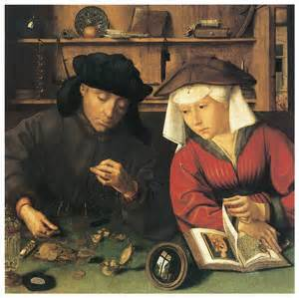
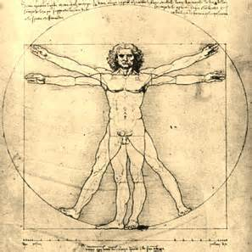
A Changing Europe
Mercantilism
Humanism
The Western European Renaissance
Protestantism

Slide 7
“The Enlightenment”
Prioritizing human reason
Methodology: induction and deduction
Natural law
Deism
Skepticism, atheism, materialism, empiricism
Human (especially European and Western Asian) history constructed as a history of Progress.
Institution of “whiteness”

Slide 8


The Commonwealth of England: 1649-1660 CE
Charles I executed by order of the Rump Parliament
England declared a republic
Oliver Cromwell rules as Lord Protector 1653-1658

Slide 9
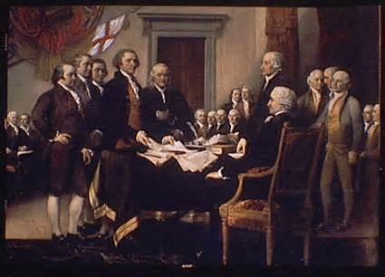
1775, The Bourgeoisie goes to War in North America, for reform
The North American settlers wage an anti-royalist war for reform. They assume management of the system, and retain property and social relations. Independence insures that the U.S. can maintain slavery as the foundation of the national wealth.

Slide 10
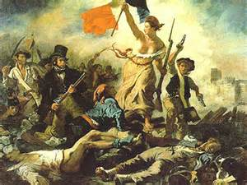
July 14, 1789 Storming the Bastille for Equality, Liberty, Fraternity and the Birth of the French Republic

Slide 11
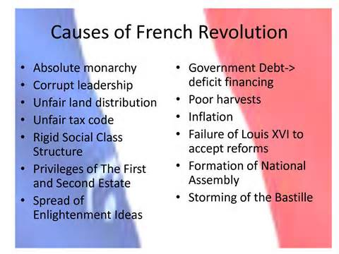
The French Revolution, a genuine revolution: property relations and social relations fundamentally change

Slide 12
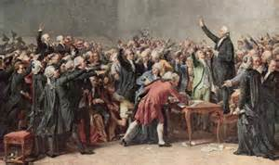
The Beginning of Political Modernity: The French National Assembly
Radical break with the Old Regime: Royalty, Aristocracy, and the Church.
Under pressure from men of color in the French National Assembly, slavery is abolished and then reinstated by Napoleon.

Slide 13
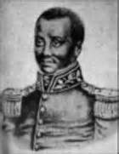
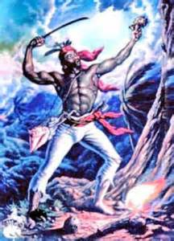
1791 Saint Domingue, the Haitian Revolution begins
Free African Communities in the mountains
Mackandal
Boukman

Slide 14
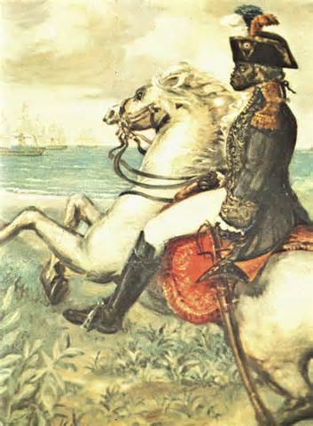
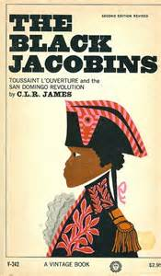
The Caribbean Front of the French Revolution: Toussaint L’Ouverture

Slide 15
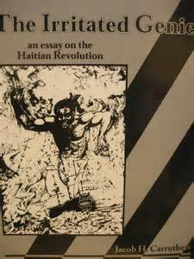
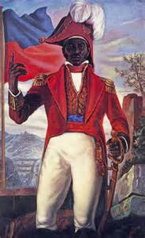
Haiti, Racial Vindication, Jean-Jacques Dessalines, and the Haitian Republic

Slide 16
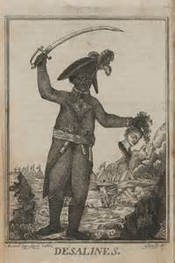
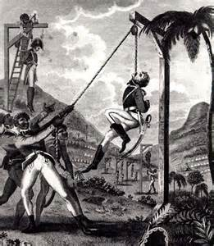
The Phantom of Liberty: Failure of the French Republic in the Caribbean
The Black Republic is isolated, surrounded by slaveholding, white ruled republics
with which Haiti is forced to deal.

Slide 17
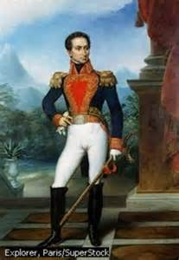
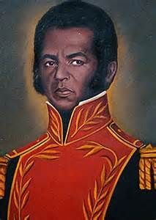
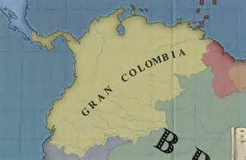
1808-1821 The Spanish American Wars of Independence: Simon Bolivar; Jose Prudencio Padilla
Africans & Afro-Mestizos were central players in all the conflicts.

Slide 18
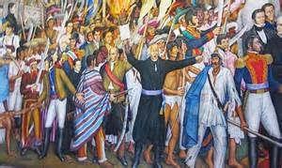
Mexico: 1810-1821

Slide 19
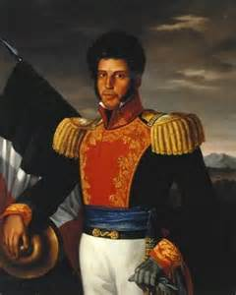
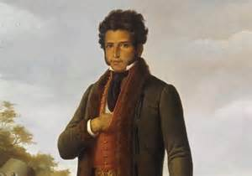
African Mexicans support independence and an end to slavery and the castas system.
Vicente Guerrero, military hero and president of the republic

Slide 20
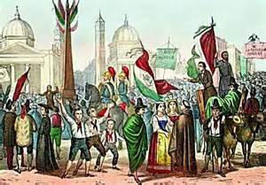
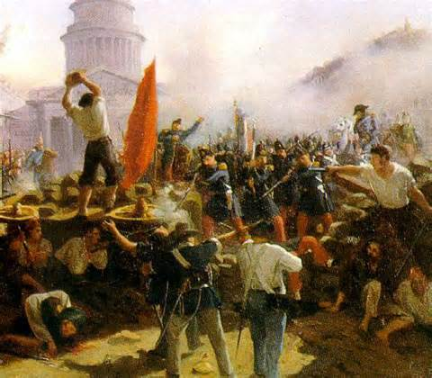
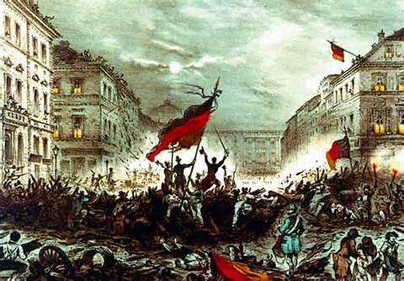
The Revolutions of 1848 in Europe
Republican uprisings against monarchies, beginning in Sicily, January1848
Nationalist uprisings against imperial governments
Call for reform and democratizing of existing institutions

Slide 21

1848 Revolutions end in some middle class reforms but mainly victory for the royalists except in France with the establishment of the Second Republic, even after restoration of the monarchy.

Slide 22
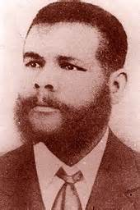
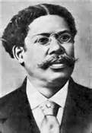
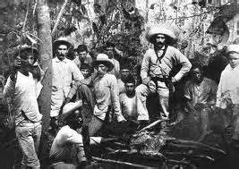
Cuba: 1868-1898
1868, Carlos Manuel de Cespedes gathered his sugar mill slaves, granted them their freedom, called them citizens and then “…invited them to help ‘conquer liberty and independence’ for Cuba.” – Ada Ferrer
For the next thirty years, Africans were central to the independence effort as commanders, soldiers, agitators, and propagandists (pictured: Antonio Maceo & Juan Gualberto Gomez).
The first effort fails because of concerns about am African majority and the threat of “another Haiti.”

Slide 23
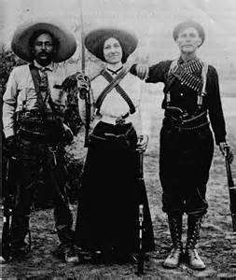
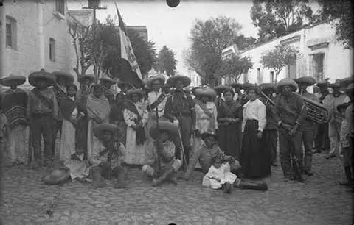
The Mexican Revolution: 1910-1920
Under the Porfirio Diaz Dictatorship, the growing, educated urban middle classes agitate for return to constitutional rule.
The rural peasantry, the vast majority of the population, agitate for massive land reform.

Slide 24
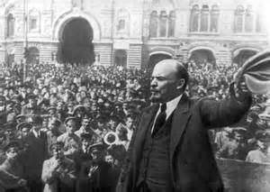
The Russian Revolution: 1917-1918
The February (March) Revolution ousts the Romanov Royal family and the Tsarist administrations, installing a Provisional Government.
The October (November) Revolution ousts the weak Provisional Government and installs the Bolsheviks with popular support of the urban workers and the soldiers under the slogan “peace, land, and bread.”
The Russian Revolution brings socialists to power in what was basically a feudal empire with a large rural population rather than an industrialized capitalist country. Like Haiti, the socialist state is isolated and surrounded.

Slide 25
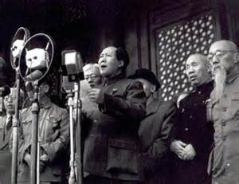
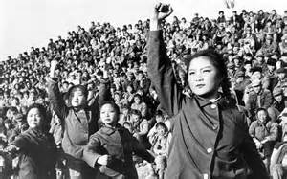
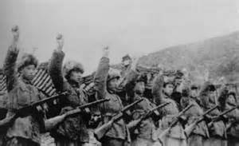
The Chinese Revolution
The Chinese Nationalist Party (Kuomintang) and the Chinese Communist Party form a United Front to fight the Japanese Occupation in 1937.
Civil War follows the defeat of Japan at the end of the Second Imperialist World War, 1946-1949.
Protracted People’s War and the triumph of the People’s Liberation Army.
Mao declares the People’s Republic of China, October 1, 1949.

Slide 26

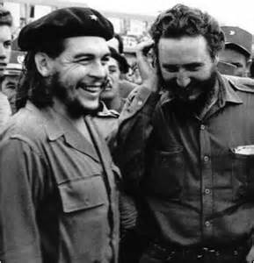
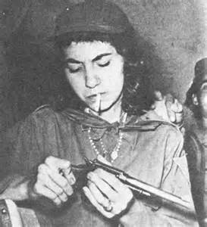
The Cuban Revolution
The 26 of July Movement
Waging People’s War against the Batista Regime
The Revolution’s Internationalism critical for revolutionary movements in Africa and Latin America

Slide 27
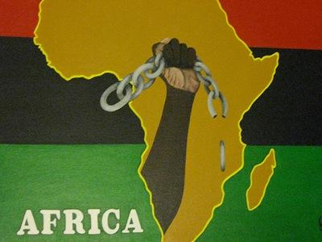
Third World Revolutions after the Second Imperialist World War
Algeria
Libya
Vietnam
Angola
Mozambique
Guinea-Bissau and Cape Verde
Nicaragua
Grenada
Zimbabwe
El Salvador
Namibia
Several African, Asian, Caribbean, and Pacific countries gain independence through decolonization processes and accords.
Internal colonies in Australasia, Europe and North and South America struggle for revolution and reform, e.g. the Civil Rights Movement and the Black Power Movement.

Slide 28




Revolution is a Process

Slide 29
Recommended Reading
The Black Jacobins C.L.R. James
The Irritated Genie Jacob H. Carruthers
Insurgent Cuba: Race, Nation, and Revolution, 1868-1898 Ada Ferrer
Liberty and Equality in Caribbean Colombia 1770-1835 Aline Helg
Prison Notebooks Antonio Gramsci
“Citizens of a Free People: Popular Liberalism and Race in Nineteenth Century Southwestern Colombia” James Sanders
The Russian Revolution Leon Trotsky
The Darker Nations: A People’s History of the Third World Vijay Prashad
Capitalism and Slavery Eric Williams
Silencing the Past: Power and the Production of History Michel-Rolph Trouillot
Imagined Communities Benedict Anderson
African Mexicans and the Discourse of Modern Nation Marco Polo Hernandez Cuevas
http://www.marxist.com/chinese-revolution-1949-one.htm

